Slide 1


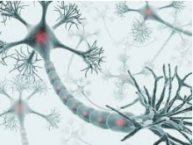
Linear Regression
Logistic Regression
Neural Network
2022/2023
Abdelwahab Naji - Enseignant chercheur
Abdelwahab.naji@gmail.com
ENSAO, Université Mohamed premier - Oujda
https://www.youtube.com/c/AbdelwahabNaji

Slide 2

Supervised Learing
Don’t start with theory
Random forest
Techniques
Decision Tree
Begin with a simple problem
1
Regression
ME
MSE
RMSE
MAE
Linear Regression
Begin with a simple technique
Supervised learning
Loss
SVR
Use a simple dataset
Neural network
Using librairies
…
ML Librairies (Black Box) :
sklearn, Keras, PyTorch ..
Supervised Learing
Decision trees
Math Librairires:
NumpY, SciPy…
Artificial intelligence
Techniques
KNN
Naive bayes
How to Learn?
Machine Learning
ML problem types
2
Classification
Binary Classification
Multi-Class Classification
Multi-Label Classification
Neural network
-
Supervised learning
Deep Learning
Loss
Cross entropy
Logarithmic Loss
Random forest
who are you?
Support Vector Machine
Confusion Matrix
Accuracy
Precision
Recall & Specificity
F1 Score
performance
…
From scratch & by hand
unsupervised Learing
K-means
How it works?
Algorithmis: Optimizers
Math
3
Clustering
Techniques
Unsupervised learning
DBScan
Calculus
Linear Algebra
Statictics
probability
Performance
Davies-Bouldin Index
Dunn Index
Silhouette Coefficient
hierarchical clustering
…

Slide 3
Machine Learning
Les éléments + étapes
1.1 Prepare Data
1. Data
1.2 Visualize Data
1.3 Split Data
2.1 Initialize the model
2.2.1 Predict
2.2 Train the model
2.2.2 calculate MSE
2.3 Get detail model
2.2.3 Update parameters
2. Model
2.4 Evaluate the model
2.5 Use the model

Slide 4
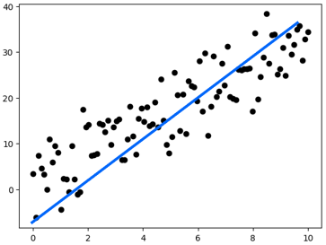
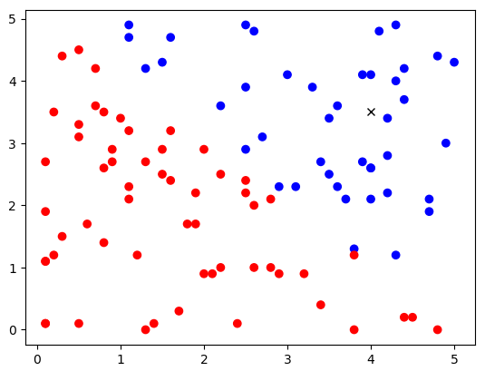
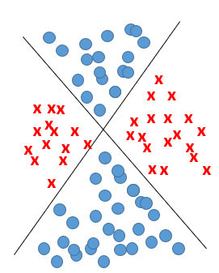
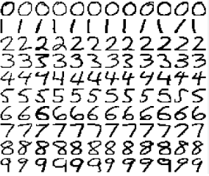
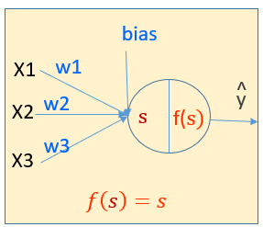
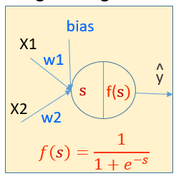
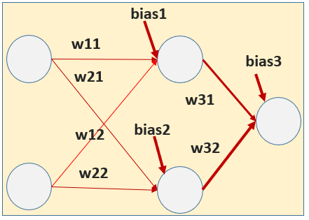
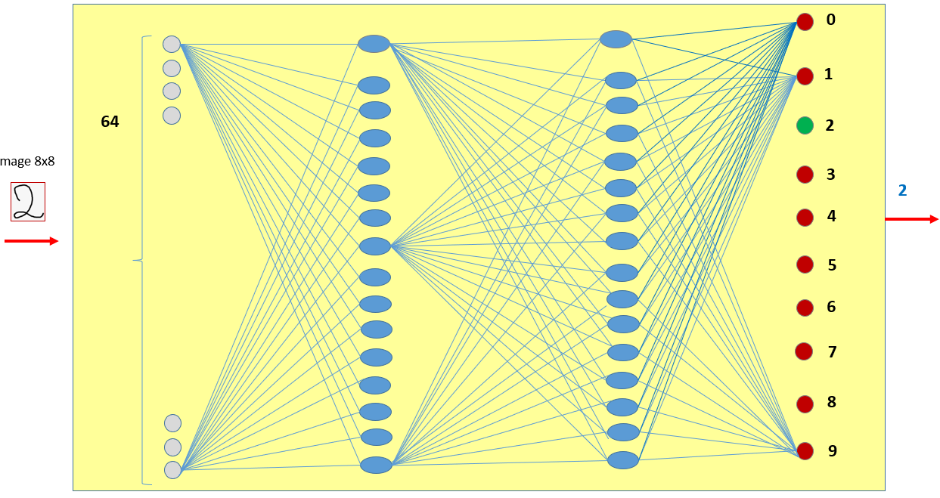
Neural Network for Supervised Learning
3
4
5
1
2
Multi Variate Linear Regression Problem
Linearly Separable problem
Non Linearly Separable problem:
Complex classification problem
Simple Linear Regression Problem
TV | Radio | Np | CA
230.1 | 37.8 | 69.2 | 22,1
44.5 | 39.3 | 45.1 | 10,4
17.2 | 45.9 | 69.3 | 9,3
…
199.8 | 2.6 | 21.2 | 10,6
Random point cloud
Advertising problem
Red or Blue?
XOR Problem
Hand Written digits Problem

Slide 5
Exemple
Une société souhaite analyser le chiffre réalisé (Sales) en fonction du budget alloué à la publicité (frais)
La publicité se fait en utilisant différents plateformes média (TV, Radio, newspaper)
Objectif: prédire le total des ventes (sales) selon les frais de publicité
Data Set
Sales à prédire
TV | Radio | Np | CA
230.1 | 37.8 | 69.2 | 22,1
44.5 | 39.3 | 45.1 | 10,4
17.2 | 45.9 | 69.3 | 9,3
151.5 | 41.3 | 58.5 | 18,5
180.8 | 10.8 | 58.4 | 12,9
8.7 | 48.9 | 75 | 7,2
57.5 | 32.8 | 23.5 | 11,8
120.2 | 19.6 | 11.6 | 13,2
8.6 | 2.1 | 1 | 4,8
199.8 | 2.6 | 21.2 | 10,6
X1=[230.1,37.8,69.2]
TV | Radio | Newspaper | Sales (target)
66.1 | 5.8 | 24.2 | ?
214.7 | 24 | 4 | ?
23.8 | 35.1 | 65.9 | ?
y1=22.1
Dans le Dataset chaque exemple d’apprentissage est accompagné par une target: Supervised Learning (Apprentissage supervisé)
Objectif: Prédire une valeur continue problème de régression
(X_{i},y_{i}): un exemple d’apprentissage
features: Tv, Radio, newsPaper (X)
target: sales (y)
Sales_predicted = bias+w₁*X1+W₂*X2+ W₃*X3
https://www.kaggle.com/ashydv/advertising-dataset

Slide 6
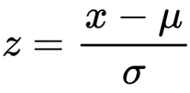
Si les valeurs de X sont grandes, afin d’éviter des mises à jours des poids très grandes, il faut standardiser les données
from sklearn.preprocessing import StandardScaler
scaler= StandardScaler()
X_st = scaler.fit_transform(X)
z: variable standardisée
μ: Moyenne
σ: Déviation standard

Slide 7
3 features, le modèle est: bias+w1*X1 +w2*X2 +w3*X3
1 feature, le modèle est: bias+w1*X1
lr=0.001
def fit(X1,X2,X3,y):
n=len(y)
w1=0
w2=0
w3=0
bias=0
for k in range(10000):
yhat=bias+w1*X1+w2*X2+w3*X3
dbias=-(2/n)*np.sum(y-yhat)
dw1=-(2/n)*np.sum(X1*(y-yhat))
dw2=-(2/n)*np.sum(X2*(y-yhat))
dw3=-(2/n)*np.sum(X3*(y-yhat))
bias=bias-dbias*lr
w1=w1-dw1*lr
w2=w2-dw2*lr
w3=w3-dw3*lr
return bias,w1,w2,w3
lr=0.01
def fit(X,y):
n=len(y)
w1=0
bias=0
for k in range(1000):
yhat=bias+w1*X
dbias=-(2/n)*np.sum(y-yhat)
dw1=-(2/n)*np.sum(X*(y-yhat))
bias=bias-dbias*lr
w1=w1-dw1*lr
return bias,w1
initialize the model
initialize the model
Predict using the model
Predict using the model
Update the model
Update the model
X1, X2 et X3 doivent être standardisés
def predict(X1):
return bias+w1*X1
#penser à la remise à l’échelle si X1 est standardisées
def predict(X1,X2,X3):
return bias+w1*X1+w2*X2+w3*X3
#penser à la remise à l’échelle si X1,X2,X3 sont standardisées

Slide 8
m features, le modèle est: bias+w1*X1 +w2*X2 +w3*X3+… +wm*Xm
X a m features
Et si on veut que fit soit capable de traiter m features!!!
lr=0.001
def fit(X,y):
n=len(y)
w1=0
w2=0
w3=0
bias=0
for k in range(10000):
yhat=bias+w1*X1+w2*X2+w3*X3
dbias=-(2/n)*np.sum(y-yhat)
dw1=-(2/n)*np.sum(X1*(y-yhat))
dw2=-(2/n)*np.sum(X2*(y-yhat))
dw3=-(2/n)*np.sum(X3*(y-yhat))
bias=bias-dbias*lr
w1=w1-dw1*lr
w2=w2-dw2*lr
w3=w3-dw3*lr
return bias,w1,w2,w3
W=np.array([0,0,0])
initialize the model
W=np.array(np.zeros(X.shape[1]))
Predict using the model
yhat=bias+np.dot(X,W)
Update the model
dW=-(2/n)* np.dot(X.T,(y-yhat))
W=W-dW*lr

Slide 9
lr=0.001
def fit(X,y):
n=len(y)
#W=np.array([0,0,0])
W=np.array(np.zeros(X.shape[1]))
# X.shape[1] est le nombre d’attributs
bias=0
for k in range(10000):
yhat=bias+np.dot(X,W)
dbias=-(2/n)*np.sum(y-yhat)
dW=-(2/n)* np.dot(X.T,(y-yhat))
bias=bias-dbias*lr
W=W-dW*lr
return bias,W
def predict(X):
return bias+np.dot(X,W)
initialize the model
Si X1, X2 et X3 ont été standardisés, il faut les rendre à leurs échelles
Predict using the model
Update the model

Slide 10

Réutiliser le même code source pour créer un réseau de neurone (un seule neurone)
Regression
Linear Regression
bias
bias
X1
X1
w1
^
w1
^
y
y
Weighted sum
activation
s
f(s)
X2
w2
X2
w2
$$f\left(s\right)=s$$
$$weighted sum=bias+w1∗X1+w2∗X2$$
Activation: une fonction d’activation
Identity or linear
Sigmoid
Tanh
Relu
Leaky ReLU
…
Le choix de la fonction d’activation dépend de…

Slide 11
Code source

Slide 12

Regression Problem by using neural network (1 neurone)
3 features, le modèle est:
lr=0.001
def fit(X1,X2,X3,y):
n=len(y)
w1=0
w2=0
w3=0
bias=0
for k in range(10000):
ws=bias+w1*X1+w2*X2+w3*X3
yhat=identity(ws)
dbias=-(2/n)*np.sum(y-yhat)
dw1=-(2/n)*np.sum(X1*(y-yhat))
dw2=-(2/n)*np.sum(X2*(y-yhat))
dw3=-(2/n)*np.sum(X3*(y-yhat))
bias=bias-dbias*lr
w1=w1-dw1*lr
w2=w2-dw2*lr
w3=w3-dw3*lr
return bias,w1,w2,w3
bias
X1
w1
^
X2
w2
y
initialize the model
s
f(s)
w3
X3
$$f\left(s\right)=s$$
Predict using the model
$$weighted sum=bias+w1∗X1+w2∗X2+w3∗X3$$
Activation: Identity or linear
Update the model
def identity(z):
return z
def predict(X1,X2,X3):
ws=bias+w1*X1+w2*X2+w3*X3
yhat=identity(ws)
return yhat

Slide 13

Regression Problem by using neural network (1 neurone)
m features, le modèle est:
lr=0.001
def fit(X,y):
n=len(y)
#W=np.array([0,0,0])
W=np.array(np.zeros(X.shape[1]))
# X.shape[1] est le nombre d’attributs
bias=0
for k in range(10000):
ws=bias+np.dot(X,W)
yhat=identity(ws)
dbias=-(2/n)*np.sum(y-yhat)
dW=-(2/n)* np.dot(X.T,(y-yhat))
bias=bias-dbias*lr
W=W-dW*lr
return bias,W
bias
X1
w1
^
X2
w2
y
initialize the model
s
f(s)
w3
X3
…
wm
Xm
Predict using the model
$$f\left(s\right)=s$$
$$weighted sum=bias+w1∗X1+…+wm∗Xm$$
Activation: Identity or linear
Update the model
def identity(z):
return z
def predict(X):
ws=bias+np.dot(X,W)
yhat=identity(ws)
return yhat

Slide 14
Neural Network for Supervised Learning
3
4
5
1
2
Multi Variate Linear Regression Problem
Linearly Separable problem
Non Linearly Separable problem:
Complex classification problem
Simple Linear Regression Problem
TV | Radio | Np | CA
230.1 | 37.8 | 69.2 | 22,1
44.5 | 39.3 | 45.1 | 10,4
17.2 | 45.9 | 69.3 | 9,3
…
199.8 | 2.6 | 21.2 | 10,6
Random point cloud
Advertising problem
Red or Blue?
XOR Problem
Hand Written digits Problem

Slide 15
Neural Network for Supervised Learning
3
4
5
1
2
Multi Variate Linear Regression Problem
Linearly Separable problem
Non Linearly Separable problem:
Complex classification problem
Simple Linear Regression Problem
TV | Radio | Np | CA
230.1 | 37.8 | 69.2 | 22,1
44.5 | 39.3 | 45.1 | 10,4
17.2 | 45.9 | 69.3 | 9,3
…
199.8 | 2.6 | 21.2 | 10,6
Random point cloud
Advertising problem
Red or Blue?
XOR Problem
Hand Written digits Problem

